Slide 1

KS3 Mathematics
D3 Bar Charts
Notes:
The aim of this unit is to teach pupils to:
Construct graphs and diagrams to represent data, on paper and using ICT.
Interpret diagrams and graphs, and draw inferences.
Compare two simple distributions using the range, mode, mean or median.
Material in this unit is linked the Framework’s supplement of examples pp262 –275.

Slide 2
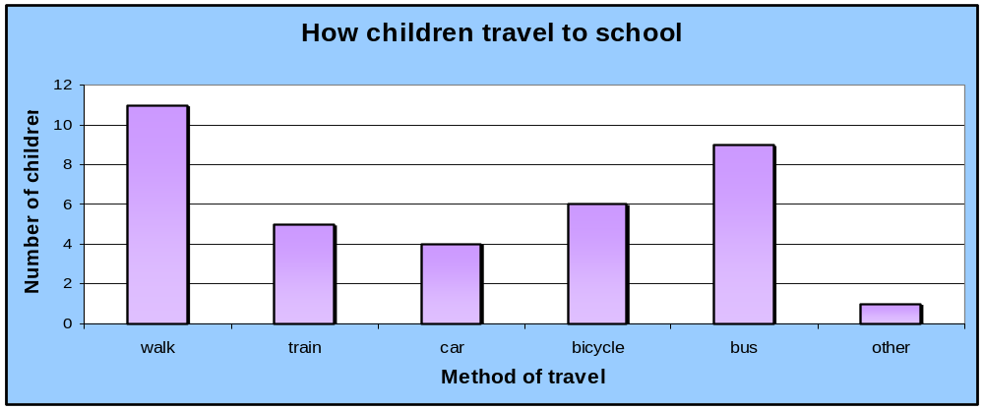


Bar charts for categorical data
Bar charts can be used to display categorical or non-numerical data.
For example, this bar graph shows how a group of children travel to school.
Notes:
Draw pupils’ attention to the gaps between the bars. The height of each bar represents the frequency for that category.
Ask questions based on this data. For example,
What is the modal method of transport?
How many of the pupils questioned travelled by train?
How many children took part in this survey?
The chart can be modified by double clicking on it.

Slide 3
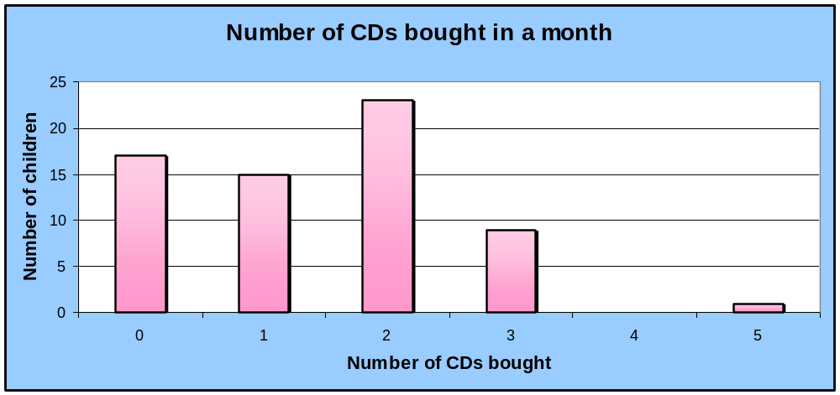
Bar charts for discrete data
Bar charts can be used to display discrete numerical data.
For example, this bar graph shows the number of CDs bought by a group of children in a given month.
Notes:
Remind pupils that discrete data is numerical data that can only take certain values. For example, we couldn’t have 2.3 CDs.
The chart can be modified by double clicking on it.

Slide 4
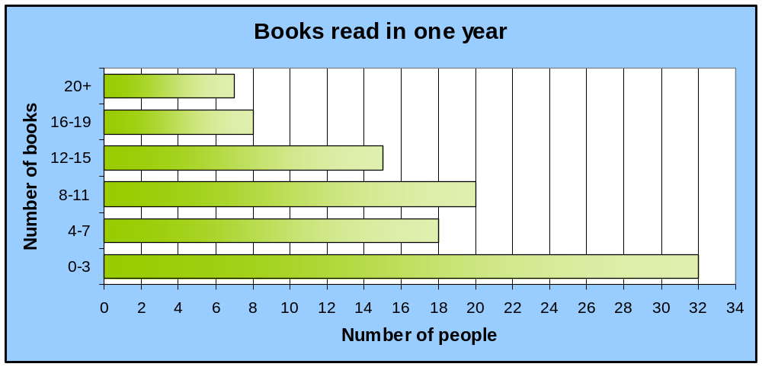
Bar charts for grouped discrete data
Bar charts can be used to display grouped discrete data.
For example, this bar graph shows the number of books read by a sample of people over the space of a year.
Notes:
This example shows a horizontal bar chart. The length of each bar represents the frequency for that class interval.
Ask pupils if we can tell from this chart how many people didn’t read a book in the previous year.
The chart can be modified by double clicking on it.

Slide 5
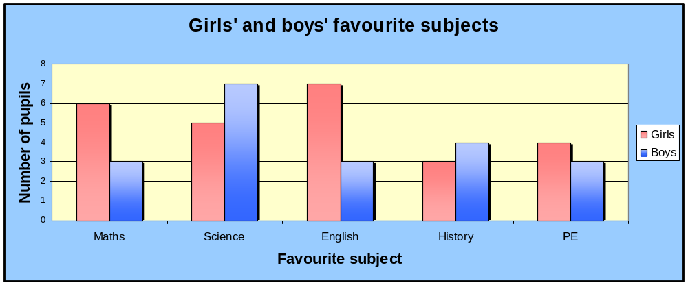
Bar charts for two sets of data
Two or more sets of data can be shown on a bar chart.
For example, this bar chart shows favourite subjects for a group of boys and girls.
Notes:
Stress that we must include a key when more than one type of data is displayed in the same chart.
Ask,
What subject did most girls like the best?
What subject did most boys like the best?
Is it possible to tell if an equal number of boys and girls took part in the survey?
The chart can be modified by double clicking on it.

Slide 6
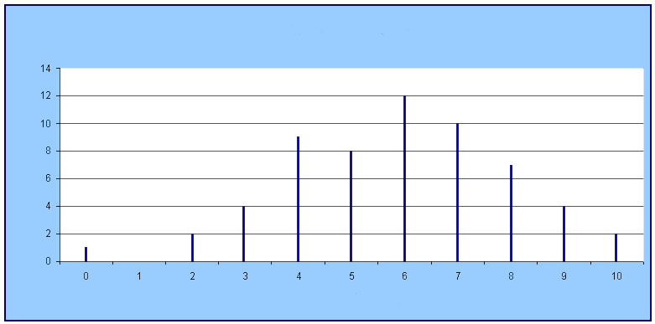
Bar line graphs
Bar line graphs are the same as bar charts except that lines are drawn instead of bars.
For example, this bar line graph shows a set of test results.
Mental maths test results
Number of pupils
Mark out of ten
Notes:
A bar line graph is more like a bar chart than like a line graph.
The heights of the lines represent the frequency. Ask,
What is the modal mark out of ten?
How many pupils sat the test? (59)
Is it possible to work out the median score for this data? (Identify the 30th mark as 6)
Is it possible to work out the mean for this data? [We could multiply the frequency for each mark by the mark and add these together to get the total score, (1 × 0) + (2 × 2) + (4 × 3) + (9 × 4) + (8 × 5) + (12 × 6) + (10 × 7) + (7 × 8) + (4 × 9) + (2 × 10) = 346. Dividing this by the total number of pupils gives 346 ÷ 59 = 5.86 to 2 d. p.]

Slide 7

Drawing bar charts
When drawing bar chart remember:
Give the bar chart a title.
Use equal intervals on the axes.
Draw bars of equal width.
Leave a gap between each bar.
Label both the axes.
Include a key for the chart if necessary.

Slide 8

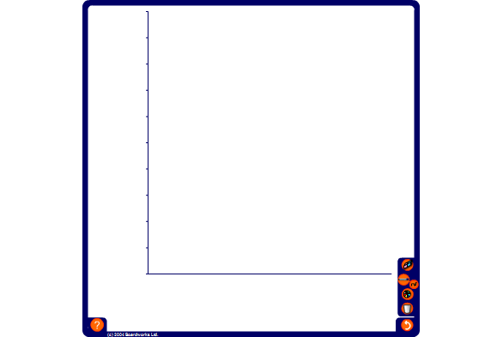
Drawing bar charts
Use the data in the frequency table to complete a bar chart showing the number of children absent from school from each year group on a particular day.
Year
Number of absences
7
74
8
53
9
32
10
11
11
10
Notes:
Start by giving the chart a title and labelling both axes. Then decide on a suitable scale for the vertical axis. For example use each division to represent ten pupils. Number this axis using the pen tool. Ask volunteers to drag each bar to the required frequency.
Copy this slide and modify the table to produce more examples if required.

